Slide 1
Thoughts on Providing the Critical District and School Leadership for K-12 Mathematics
UVU UCTM
November 6, 2015
Steve Leinwand
American Institutes for Research
SLeinwand@air.org www.steveleinwand.com

Slide 2
It’s TIME
It’s TIME we do it right
CCSSM, PARCC and SBAC create once in a career opps
It’s TIME we use our unity – Math Wars are history
It’s TIME we stop settling for mediocrity and programs that fail to serve nearly enough students
It’s TIME we stop making excuses or let others make excuses for not doing what needs to be done
It’s TIME we demand and implement what we know works
It’s TIME we take the action needed to finally make mathematics work for every student in every school

Slide 3
What do you see?

Slide 4
What do you see?

Slide 5
Versus
Identify three things you see.
Convince us.
On your white boards, A triangle is:
Compare to google/wikipedia

Slide 6
What is a triangle?
a plane figure with three straight sides and three angles.
"an equilateral triangle"
a thing shaped like a triangle.
"a small triangle of grass"
a situation involving three people or things, especially an emotional relationship involving a couple and a third person with whom one of them is involved.
noun: eternal triangle; plural noun: eternal triangles

Slide 7
You choose:
1.59 ) 10
vs.
You have $10. Big Macs cost $1.59
SO?

Slide 8
You choose….
The one right way to get the one right answer that no one cares about and isn’t even asked on the state tests
vs.
Where am I? (the McDonalds context)
Ten? Convince me.
About how many? How do you know?
Exactly how many? How do you know?
Oops – On sale for $1.29 and I have $20.

Slide 9
You choose:
Given: F = 4 (S – 65) + 10
Find F when S = 81.
Vs.
The speeding fine in Vermont is $4 for every mile per hour over the 65 mph limit plus $10 handling fee.

Slide 10
Connecticut: F = 10 ( S – 55) + 40
Maximum speeding fine: $350
Describe the fine in words
At what speed does it no longer matter?
At 80 mph how much better off would you be in VT than in CT?
Use a graph to show this difference

Slide 11
What is 1/10 of 450?

Slide 12
Convince us that 1/10 of 450
is 45.

Slide 13
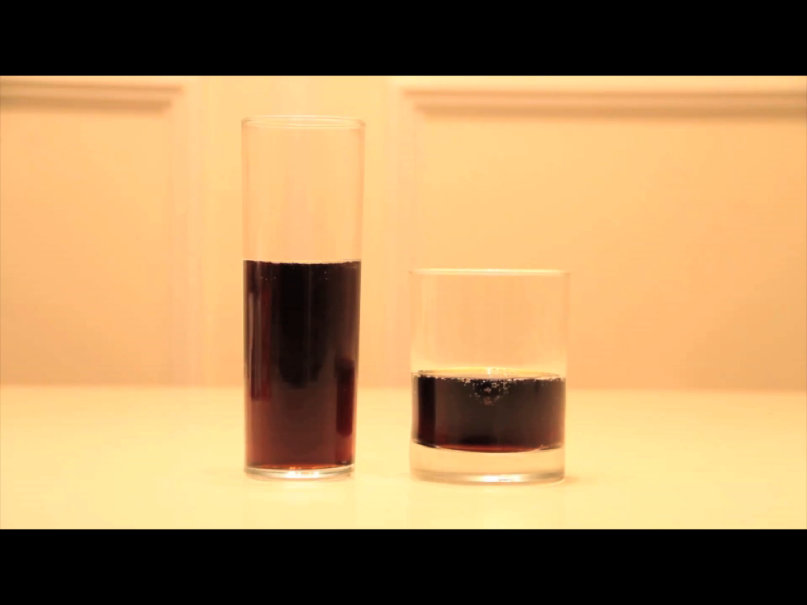
Tell your partner three things you see here.
Notes:
Goal:
The goal of this slide is to ask students to apply their intuition, make a guess and justify their guess. Because they’ve guessed, students may now be curious to know which of them guessed correctly. and guess an answer. After this slide, students may want to know which of them guessed correctly.
Teaching Moves:
Ask students to write down guesses. Say, “Would you please write down on your handout which you think has more: the left or the right? Or do they have exactly the same?” [Why?]
Ask students to pair and share. Say, “Share your guess with your neighbor. Do you both agree? Do you disagree?”
Take a classwide poll of guesses. Ask for a show of hands. “Who thinks the left one has more? The right? The same?” Write down approximate counts of the guesses on the board. [Why?]
Interesting Outcomes:
The class is divided. The video IS intendED to create controversy. The ideal outcome has the class split into two or three groups of different opinions. At that point, the more you can play up the controversy (“Oooo ... big fight. We can’t all be right, people!”) the more interested students will be in the answer. [Why?]

Slide 14
What is your guess for which glass has more? Share your guess with your neighbor and justify your guess.
Notes:
Goal:
The goal of this slide is to ask students to apply their intuition, make a guess and justify their guess. Because they’ve guessed, students may now be curious to know which of them guessed correctly. and guess an answer. After this slide, students may want to know which of them guessed correctly.
Teaching Moves:
Ask students to write down guesses. Say, “Would you please write down on your handout which you think has more: the left or the right? Or do they have exactly the same?” [Why?]
Ask students to pair and share. Say, “Share your guess with your neighbor. Do you both agree? Do you disagree?”
Take a classwide poll of guesses. Ask for a show of hands. “Who thinks the left one has more? The right? The same?” Write down approximate counts of the guesses on the board. [Why?]
Interesting Outcomes:
The class is divided. The video IS intendED to create controversy. The ideal outcome has the class split into two or three groups of different opinions. At that point, the more you can play up the controversy (“Oooo ... big fight. We can’t all be right, people!”) the more interested students will be in the answer. [Why?]

Slide 15
What information is important here?
How would you get it?
Notes:
Goal:
The goal of this slide is for students to see that diameter and height are the essential variables for finding volume and also the easiest to measure with a ruler.
Teaching Moves:
Ask students what information is important. Ask, “What information would be useful to know here and how would you get it? Would you write down some ideas for yourself on your handout?” [Why?]
Ask students to pair and share. Say, “Share your ideas with your neighbor. Do you both agree? Do you disagree about what’s necessary?”
Make a list of information requested. Ask students to share the information they want. Write suggestions on the board next to the owner’s name or type them in a document, depending on which is faster for you. But record everything. The goal here isn’t to pass judgment on good and bad suggestions. It’s to collect student ideas. There’s no need to collect every student’s idea, though. Once you’ve recorded a broad cross-section of the class’ ideas, cut the process short. [Why?]
Push students for precision. See the interesting outcomes below and how you might respond. As you pull and tug on certain students’ responses, put a star or some marking next to the suggestion to illustrate that you’ve addressed it. It isn’t necessary to address all of them. This is a chance to redirect students to more precise mathematical vocabulary. For example, some teachers would start a lesson by introducing the vocabulary. However we didn't, so when students say, "We need to know how tall and wide the glasses are" teachers can say something, "When we are talking about cylinders, we call how tall they are their height and how wide they are their diameter
Interesting Outcomes:
Students ask for a measuring cup so they can find volume. Take this one first. Say something like, “Great idea. That’d be so easy and we could all get out of here for break. But unfortunately I don’t have a measuring cup and all I’m working with at the moment is a ruler.”
Students ask for “height.” This isn’t very precise so we’ll push on it. Say, “Okay, when you ask for height? You’re looking for this height here, right?” Then put your fingers from the very top of the glass to the very bottom of the glass. They need to tell you, “No, we want the height of the soda.”
Students ask for “radius” or “diameter” or “circumference.” Talk about how we know we can turn any one of those facts into any of the others. But which of those three is easiest to get and which is hardest? Have them think about the question for a minute and write down a response, then share it with a neighbor.
Radius. Radius is difficult because it relies on finding the center of the glass, which is invisible.
Circumference. Circumference is difficult with a ruler, of course. But even if you allow a piece of string (or a seamstress’ tape) it doesn’t help to pull the string taut around the outside of the glass because that will include the thickness of the glass in with the soda. It’s difficult to pull the string taut around the inside of the glass, which is what’s required.
Diameter. Diameter may seem easiest but it too relies on finding the center of the circle. We know a curious fact about circles that may be very helpful, though: The diameter is the longest chord in a circle. So fix one end of the ruler to a point on the circumference of the glass and then rotate the ruler around the rest of the glass. The longest measurement has to be the diameter.
Students ask for some extremely precise information. For example, “Is it really a cylinder?” or “What about the thickness of the glass?” or “Is the bottom of the glass really flat?” It may seem initially that these students are being disruptive or disagreeable but every other student ought to emulate this attention to precision. Answer these questions directly and with sincerity, “It’s really a cylinder.” and “We’ll get measurements that take the thickness of the glass into consideration.” and “The bottom of the glass is really flat.” Then throw a lot of praise on them.’’

Slide 16
5.5 cm
7 cm
10 cm
3 cm
Notes:
Goal:
The goal of this slide is to give students the information you’ve settled on as most precise and easiest to measure with the tools on hand, all without implying a specific solution strategy yet. The goal of this slide is that students struggle productively, and come to so that they crave more information so they can know what to do with this information and worry abouat what to do with this information, all before you teach them the formula for volume.
Teaching Moves:
Give them some time to struggle. Say, “Okay, you guys asked for this information because you had some rough, fuzzy plan for it. I want you to take a minute to work on your own and put that plan into action.” [Why?]
Ask them to share ideas with their neighbors. Don’t expect your students to just “discover” the formula for cylinder volume. Don’t expect all this understanding to arise without some intervention on your part. But if students invest time and struggle in the question, they’ll want the explanation even more and be in a better place to appreciate it.
Interesting Outcomes:
They don’t solve the problem. In this case we’ll move to the lecture in the next slide.
Some students solve the problem. This is always a possibility. If a student solves the task quickly, pose one of the extension questions we’ve included in later slides.

Slide 18
Was anything learned?
Now draw two glasses with different diameters and show the heights of equal amounts of liquid. Explain your reasoning.
And on the unit test…..

Slide 19
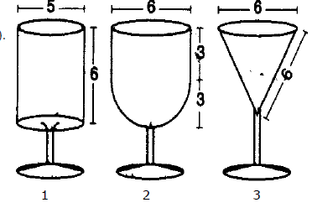
Your turn:

Slide 20
So?
Order from smallest to largest and justify
What is the height of Glass 3?
What is the volume of each?
If Glass 1 has volume V, express volume of Glasses 2 and 3 in terms of V
When Glass 1 is ½ full, the height of the liquid is 3 cm. What are the heights of the liquid in Glasses 2 and 3 when they are ½ full?

Slide 21
Exit slip: Sketch an object and it’s dimensions that has a surface area of about 100 square inches?
Homework: How many square cm of skin do you have and be prepared to show how you arrived at your answer.

Slide 22
Why do you think I used these tasks?
Standards don’t teach, teachers teach
It’s the translation of the words into tasks and instruction and assessments that really matter
Processes are as important as content
We need to give kids (and ourselves) a reason to care
Difficult, unlikely, to do alone!!!

Slide 23
Here, in 6 parts,
is what we know.

Slide 24
1. The key things we know
People won’t do what they can’t envision,
People can’t do what they don’t understand,
People can’t do well what isn’t practiced,
But practice without feedback results in little change, and
Work without collaboration is not sustaining.
Ergo: Our job, as professionals, at its core, is to help people envision, understand, practice, receive feedback and collaborate.

Slide 25
2. The 5 Core Elements of a Math Program
A coherent and aligned curriculum that includes a set of grade level content expectations, appropriate print and electronic instructional materials, with a pacing guide that links the content standards, the materials and the calendar;
High levels of instructional effectiveness, guided by a common vision of effective teaching of mathematics and supported by deliberate planning, reflection and attention to the details of effective practice;
A set of aligned benchmark and summative assessments that allow for monitoring of student, teacher and school accomplishment at the unit/chapter and grade/course levels;

Slide 26
Student support for students who are struggling.
Professional growth within a professional culture of dignity, transparency, collaboration and support.

Slide 27
Professional Culture
What?
How?
How well and with what student support?

Slide 28
3. The four key elements of an effective lesson:
The Math: leaning goals, appropriateness, the big ideas, connections, common errors and misconceptions.
The Tasks: that is the tasks, problems, activities and their richness, alignment with the goals, their appropriateness, their sequencing.
The Questions and Discourse: how the tasks are orchestrated and conveyed: directions, questions, who is doing the work, scaffolding, reviewing and debriefing.
The Assessment: the evidence that is gathered to determine how well the learning goals were met.

Slide 29
4. CCSSM Mathematical Practices (the first four)
Make sense of problems and persevere in solving them.
Reason abstractly and quantitatively.
Construct viable arguments and critique the reasoning of others.
Model with mathematics.

Slide 30
5. Principles to Actions: Ensuring Mathematical Success for All
Mathematics Teaching Practices
Establish mathematics goals to focus learning.
Implement tasks that promote reasoning and problem solving.
Use and connect mathematical representations.
Facilitate meaningful mathematical discourse.
Pose purposeful questions.
Build procedural fluency from conceptual understanding.
Support productive struggle in learning mathematics.
Elicit and use evidence of student thinking.

Slide 31
**6. A Progression of Insights**
We are charged with making math work for a much greater proportion of students.
But typical instructional practice of showing, telling and practicing to get “right answers” only works for about 1/3.
To complicate matters, today’s world requires reasoning, solving problems, constructing viable arguments (SMPs).
Thus math classes must reflect a different set of instructional practices – productive struggle, alternative approaches and multiple representations, discourse, explanations, conjectures and justifications (MTPs).
But, this is different, difficult to do, requires time and risk-taking.
Which is why we must have collaborative structures and coaching to support envisioning, practicing and providing feedback as we raise quality and impact.

Slide 32
How do we bring all of this to scale in every classroom every day?
We begin with an action plan.

Slide 33
First, it will take:
The time, leadership and opportunity for collaborative structures.

Slide 34
To collaborate, we need time and structures
Structured and focused department meetings, grade level meetings, course committees, and PLCs
Before school breakfast sessions
Common planning time – by grade and by department
Pizza and beer/wine after school sessions
Released time 1 p.m. to 4 p.m. sessions
Hiring substitutes to release teachers for classroom visits
Coach or principal teaching one or more classes to free up teacher to visit colleagues
After school sessions with teacher who visited, teacher who was visited and the principal and/or coach to debrief
Summer workshops
Department seminars

Slide 35
Vehicles, not ends
Collegial classroom visits and debrief discussions
Task analysis
Collaborative planning
Co-teaching and co-planning
Common readings
Lesson study
Instructional rounds
Analysis of student work
Data reviews and actions
Video analysis
Learning communities
Gallery teaching
Common problem resolution discussions and plans

Slide 36
Never forget:
It’s not a PLC that magically makes a difference. It’s the content of, and follow-up and change that emerges from, the professional sharing and interaction that enhances the day-in-and-day-out opportunities for kids to learn mathematics!

Slide 37
Second, it will take:
Knowledgeable, assertive, passionate, sensitive, respectful coaching.

Slide 38
Question #1
Why would you tell a teacher whom you are coaching to differentiate,
when you could be modeling differentiation in his/her classroom? (“who got the same answer in a different way?)

Slide 39
Co-teaching without co-teaching Interjecting myself into the class without being a distraction
“85”: The perfect moment, from the back of the room for: “Really, why is that?”, “Hold it a sec, can you convince your partner that it’s 85? [PAUSE] Go ahead and try it.” (becomes great folder for discussion about missed opportunities and reasoning and alternative approaches)

Slide 40
Question #2
Why would you tell a teacher whom you are coaching about missed opportunities (“why?”, a chance to probe, a representation),
when you yourself could have done that during the lesson?

Slide 41
Co-teaching without co-teaching Interjecting myself into the class without being a distraction
2 and 2/3: [and from the back of the room:] “Cool. Did everyone of you do it that way? No? Can you come up and show us another way? Anyone else?

Slide 42
Question #3
Why would you talk about using representations in the abstract,
when you could have drawn a bar model or silently gone to Desmos?

Slide 43
Co-teaching without co-teaching Interjecting myself into the class without being a distraction
While students are explaining or teaching is talking away abstracting, sidle up to the board or the computer and capture the explanation with a picture or a diagram. You rarely need to do anything else to get the discussion focused on what you’re written or drawn.

Slide 44
Question #4
Why would you ever observe an entire lesson,
And not provide oral and written feedback, an opportunity to discuss the lesson, and begin to craft an action plan ?

Slide 45
That’s how coaching can significantly enhance the quality of teaching and thus student learning.

Slide 46
Third, it will take the amazing array of free, great, on-line resources
http://emergentmath.com/my-problem-based-curriculum-maps

Slide 47
http://emergentmath.com/my-problem-based-curriculum-maps

Slide 48
And fourth, it will take:
Your individual and collective initiative!
Do it, do it well, do it even better!

Slide 49
Questions

Slide 50
Thank you!

